Slide 1

SVM using CUDA
Contributed by:
Hardik Thami
19114035

Slide 2
Introduction
Support Vector Machine (SVM) is a Supervised Machine Learning Model.
It is a binary classifier i.e. classifying data into two groups.
Classification is done by defining a hyperplane that is at maximum distance from all points.
Project is used to classify sample data set to classes {-1, 1}
SVM has been implemented on both CPU and GPU

Slide 3

Theory
Hyperplane is defined by
$${\overline{y}}_{i}\left({\overline{x}}_{i}⋅\overline{w}+b\right)−1=0$$
Where ${\overline{y}}_{i}$ - class of a data point
${\overline{x}}_{i}$ - input data point (features)
$\overline{w}$ - weights
$b$ - bias

Slide 4
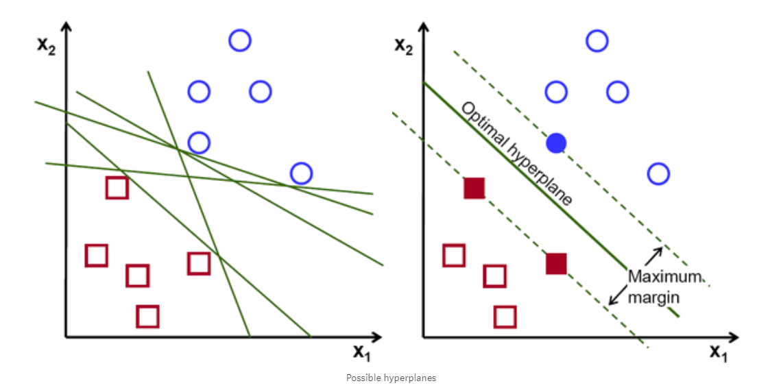

Contd.
Hyperplane is used to classify.
If a new data point satisfies $\left({\overline{x}}_{i}⋅\overline{w}+b\right)−1<0$, then class is -1.
If it is greater than 0, then class is 1.
To train a SVM, we have to find least ||w|| and least b that satisfies
${\overline{y}}_{i}\left({\overline{x}}_{i}⋅\overline{w}+b\right)−1$ = 0.

Slide 5
References
[1] Medium - https://medium.com/@LSchultebraucks/introduction-to-support-vector-machines-9f8161ae2fcb
[2] towardsdatascience.com -https://towardsdatascience.com/support-vector-machine-introduction-to-machine-learning-algorithms-934a444fca47

